Slide 1
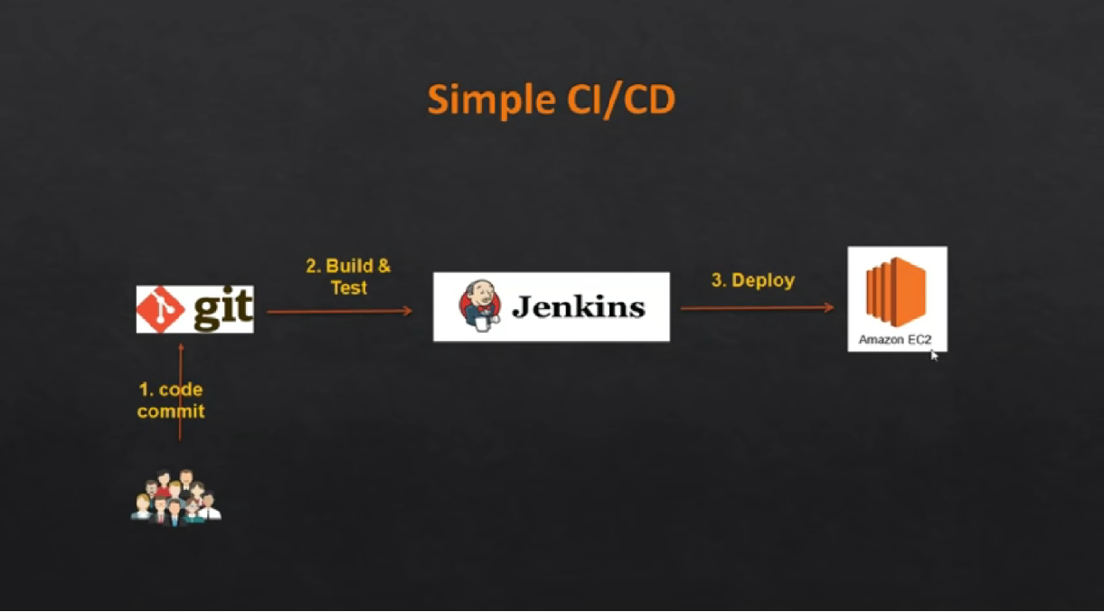
CICD Project – 1
We know how to use work with each and Git, Jenkins independently. What if you want to collaborate these two? that is where Simple DevOps project helps you. Follow below steps if you are a new guy to DevOps. You love it.

Slide 2
Background
Build a simple CICD project that uses Jenkins and plugins to deploy code from Git to Apache Tomcat EC2 server.
Objectives
Install Maven (a tool that can now be used for building and managing any Java-based project) on Jenkins Bitnami Marketplace T2 Small instance
Manage all plugins into Jenkins (Java –JDK, Maven – Invoker & Plugin; Install git; Tomcat)
Edit a bunch of files in Jenkins and Tomcat servers – Add users on Tomcat so that you can use from GUI
Configure war files, containers and user name and password
Deploy the automated pipeline into Tomcat EC2 instance

Slide 3
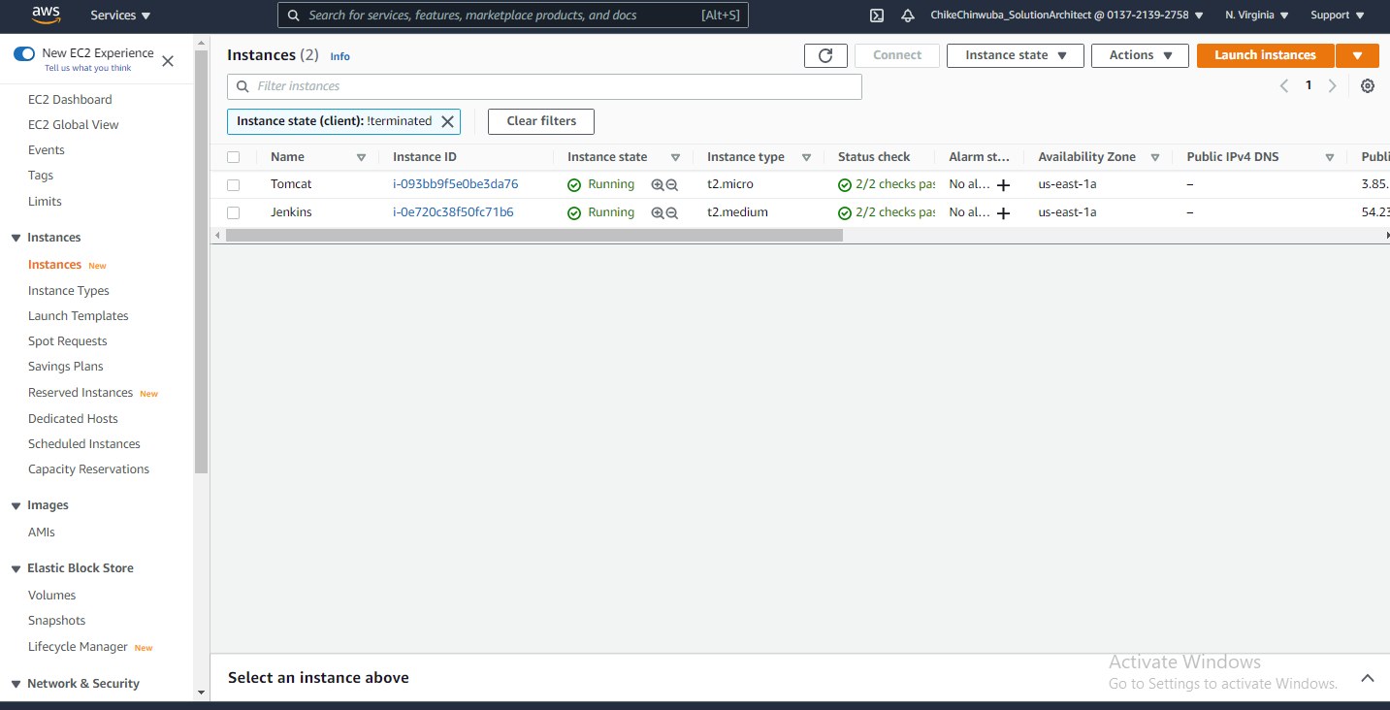
Jenkins T2 Medium and Tomcat Ubuntu Servers

Slide 4
Install Maven into the Bitnami Marketplace instance
https://www.youtube.com/watch?v=wgfsVmHnAiM
Download maven on Jenkins server. In our case it is /opt/maven
Link: - http://maven.apache.org/download.cgi
# sudo su -
# mkdir /opt/maven
# cd /opt/maven
# wget https://mirrors.estointernet.in/apache/maven/maven-3/3.6.3/binaries/apache-maven-3.6.3-bin.tar.gz
# tar xzvf apache-maven-3*tar.gz -C /opt/maven
Setup M2_HOME and M2 Paths in environment variable
Switch to root “sudo su – “ and
Open ~/.bash_profile and paste
for Bitnami Image we have different java path (whereis java)
# User specific environment and startup programs
JAVA_HOME=/opt/bitnami/java/
M2_HOME=/opt/maven/apache-maven-3.6.3
M2=$M2_HOME/bin
PATH=$PATH:$JAVA_HOME:$M2_HOME:M2:$HOME/bin
export PATH

Slide 5
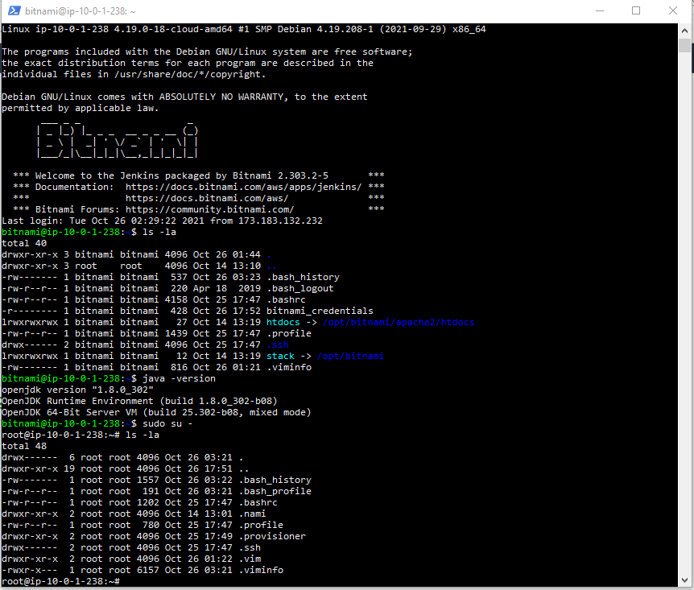
Edit and incorporate Environment variables

Slide 6
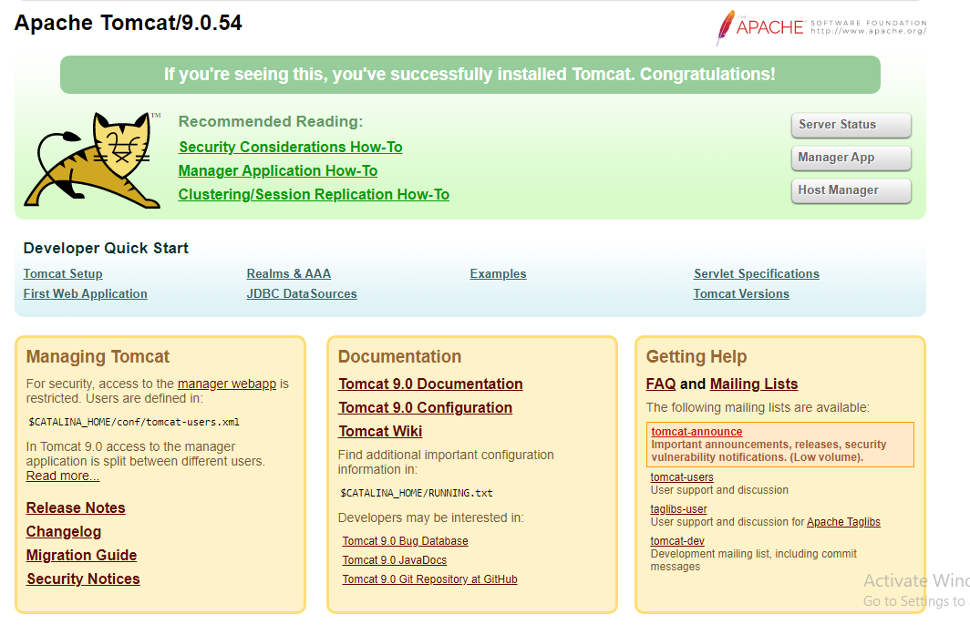
Deploying tomcat using Ipadd :8080

Slide 7
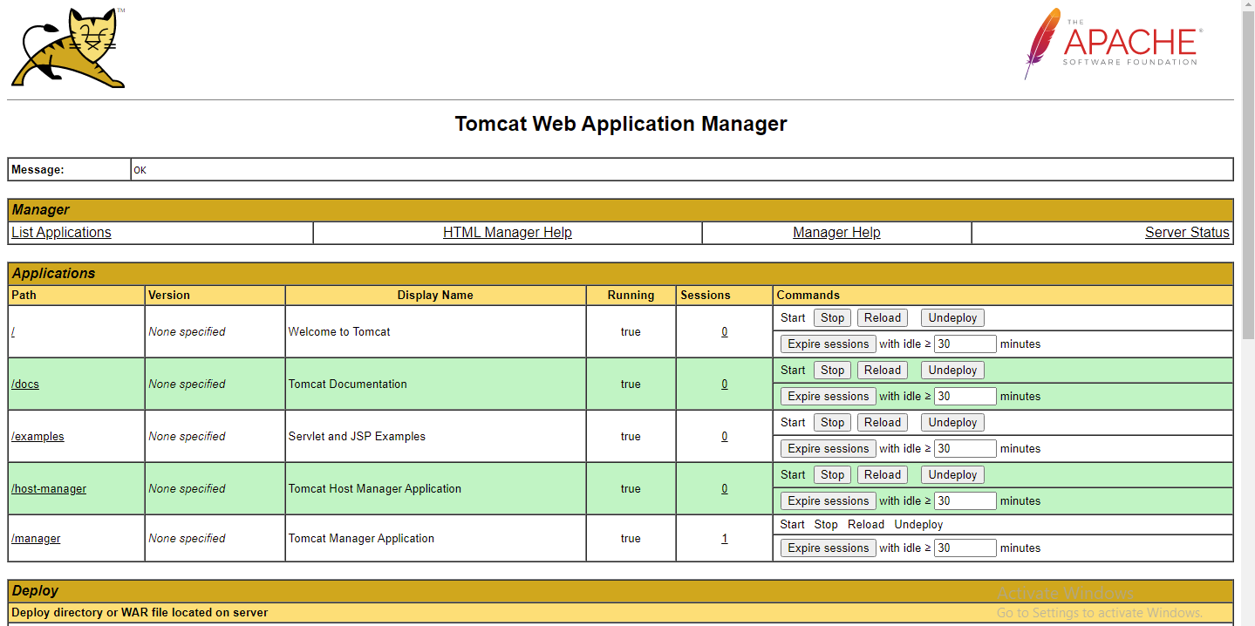
Logging into Tomcat using tomcat user

Slide 8
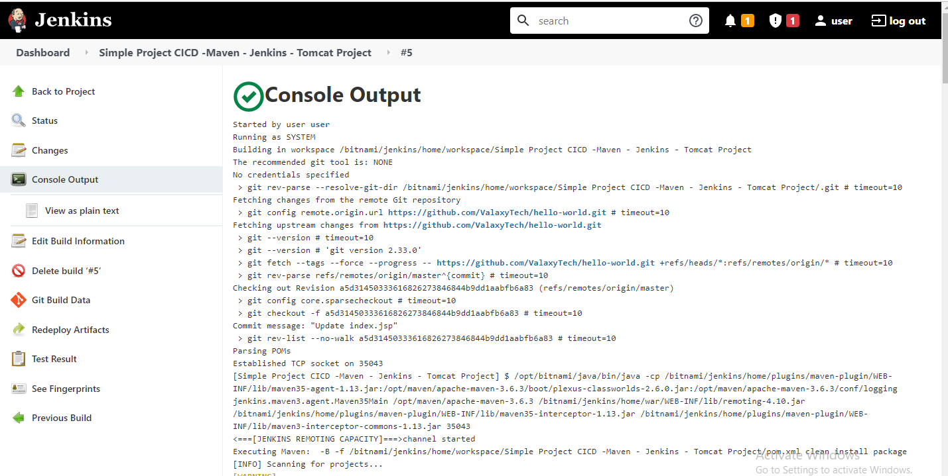
Console output – Build Successful

Slide 9
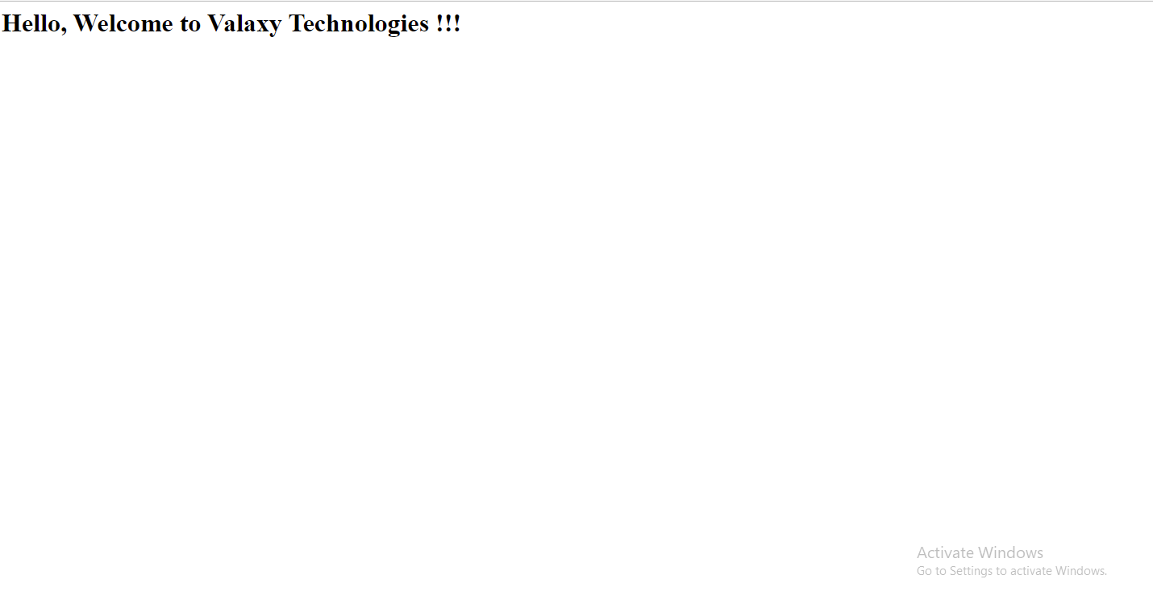
Webapp from Github successful

